Slide 1


Rapido Ride Analysis: Unlocking Insights from Bangalore Data
This presentation explores key insights derived from analyzing Rapido ride data in Bangalore, focusing on understanding peak demand periods, customer behavior, service delays, and optimization strategies. By leveraging exploratory data analysis, we aim to enhance operational efficiency and user satisfaction.

Slide 2

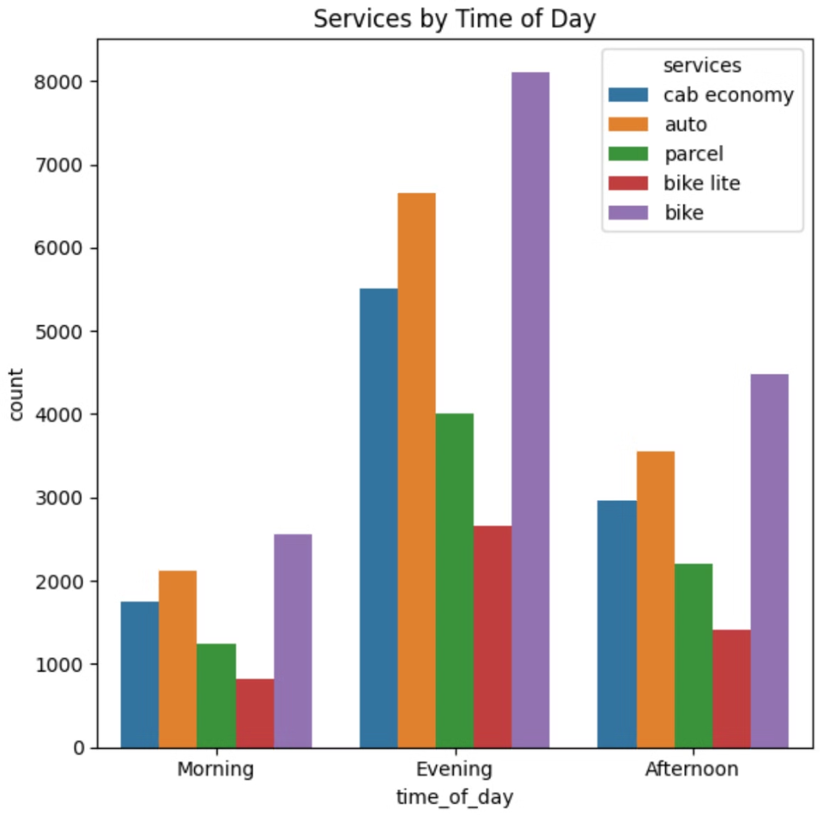
Understanding Peak Demand and Customer Behavior Trends
1
Morning
A significant surge in ride requests occurs between 6:00 AM and 10:00 AM, driven by commuters heading to work or school.
2
Afternoon
A moderate increase in demand is observed between 10:00 PM and 5:00 PM, primarily due to people seeking lunch breaks or appointments.
3
Evening
A sharp spike in ride requests is witnessed between 5:00 PM and 8:00 PM, as people commute back home from work or errands.

Slide 3


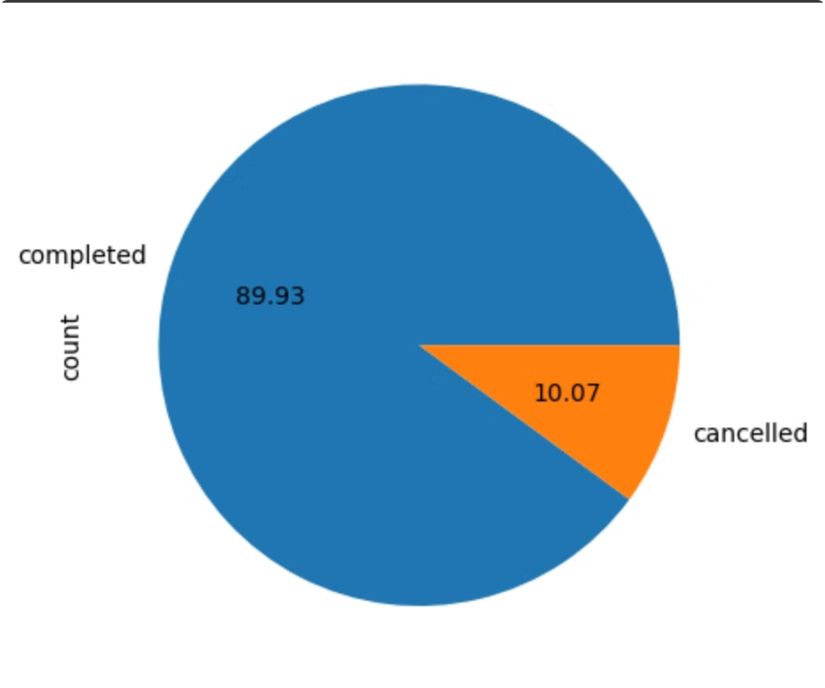


Identifying Factors Behind Service Delays and Cancellations
Traffic Congestion
Heavy traffic during peak hours can significantly impact ride duration and lead to delays.
Driver Availability
Limited driver availability during peak demand periods can result in longer wait times or cancellations.
Rider Behavior
Unforeseen changes in ride destinations or last-minute cancellations by riders can contribute to delays.

Slide 4





Optimizing Ride Allocation for Reduced Wait Times
Real-Time Demand Mapping
Analyzing ride requests in real-time to identify areas with high demand.
Driver Re-allocation
Dynamically re-allocating drivers to areas experiencing high demand to minimize wait times.
Ride Matching Algorithm
Optimizing ride matching based on distance, driver availability, and estimated travel time.

Slide 5

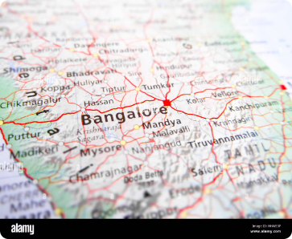
Mapping Location-Specific Ride Patterns for Better Coverage
1
Popular Origins and Destinations
2
Demand Fluctuation
3
Service Gap Analysis
Analyzing variations in demand across different time periods and days of the week.
Identifying areas with low driver availability or infrequent ride requests.
Identifying areas with high concentration of ride requests and popular travel routes.

Slide 6


Enhancing Operational Efficiency and User Satisfaction
Improved Driver Utilization
Reduced Wait Times
Minimizing wait times for riders by matching them with available drivers in a timely manner.
Optimizing ride allocation to ensure drivers are efficiently utilized and avoid idle time.
Enhanced Service Coverage
Expanding service coverage to cater to demand in underserved areas and improve accessibility.

Slide 7






Conclusion and Key Takeaways
Targeted Driver Allocation
Time-Based Pricing
Service Area Expansion
Customer Feedback Integration
Implement dynamic pricing strategies to adjust ride fares during peak hours, incentivizing driver availability.
Expand service coverage to underserved areas based on demand analysis and potential for growth.
Allocate drivers strategically based on real-time demand patterns to reduce wait times.
Continuously gather and analyze customer feedback to enhance service quality and address concerns.

